Slide 1

The Weather Project
Presented by: [Your Name]
Date: October 26, 2024

Slide 2


Motivation: Why Build a Weather Project?
Weather impacts daily life, from planning outfits to scheduling outdoor activities. Accurate and accessible weather information is crucial for informed decision-making, safety, and convenience.
Daily Planning
Safety & Preparedness
Empowering users to plan their day effectively.
Providing timely warnings for severe weather events.
Data Accessibility
Making complex weather data easy to understand and use.

Slide 3

Project Objective: Our Weather System
The Weather Project aims to develop a robust and user-friendly system that provides real-time weather data and accurate forecasts. Our goal is to deliver essential weather information directly to users, enhancing their daily lives.
Real-time Data
Accurate Forecasts
User-Friendly Interface
Instant access to current weather conditions.
Reliable predictions for the coming days.
Intuitive design for easy navigation and understanding.

Slide 4


Architecture & Workflow
Our system collects raw weather data from external APIs, processes it, and stores it in a database. This processed data is then served to the user interface, ensuring a smooth and efficient flow of information.
Collect Data
Process Data
Store Data
Serve UI

Slide 5





Technology Stack
We leverage a combination of powerful languages, frameworks, and APIs to build a scalable and efficient weather application. This stack ensures reliability and performance across all components.
Python
Java
Backend logic and data processing.
Robust API integration and server-side operations.
Database
Weather API
Efficient storage and retrieval of weather data.
External data source for comprehensive weather information.

Slide 6






Features & Functionalities
The Weather Project offers a comprehensive suite of features designed to keep users informed about current and future weather conditions. From basic temperature readings to detailed humidity levels, we cover it all.
Current Temperature
Real-time temperature updates for any location.
Daily Forecast
Detailed predictions for the next 24-48 hours.
Humidity Levels
Precise humidity readings to assess comfort.
Wind Speed & Direction
Important data for outdoor activities and safety.

Slide 7

APIs & Data Source
Our system relies on a robust external weather API to fetch accurate and up-to-date meteorological data. This API provides a wide range of weather parameters, ensuring comprehensive coverage.
OpenWeatherMap API
Global weather data coverage.
Real-time and historical data.
Forecasts for up to 16 days.
Supports various data formats (JSON, XML).
Data retrieval is managed through scheduled calls to the API, ensuring our database is consistently updated with the latest information.

Slide 8
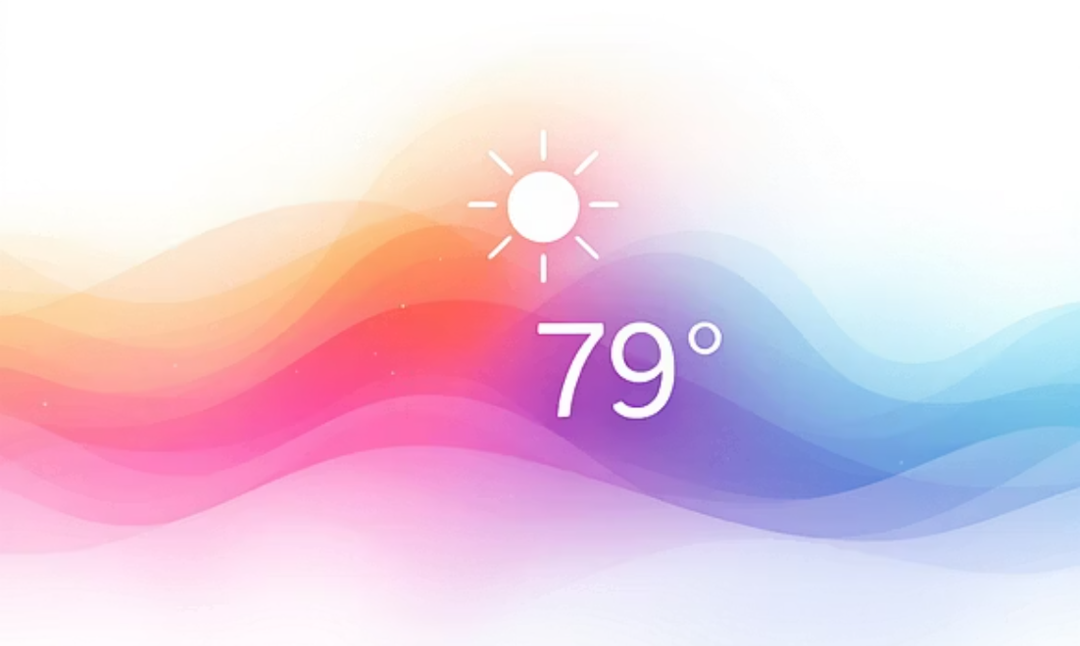
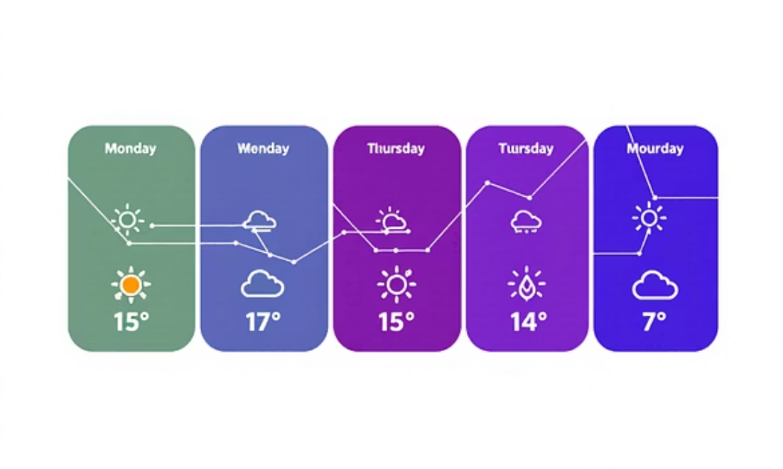
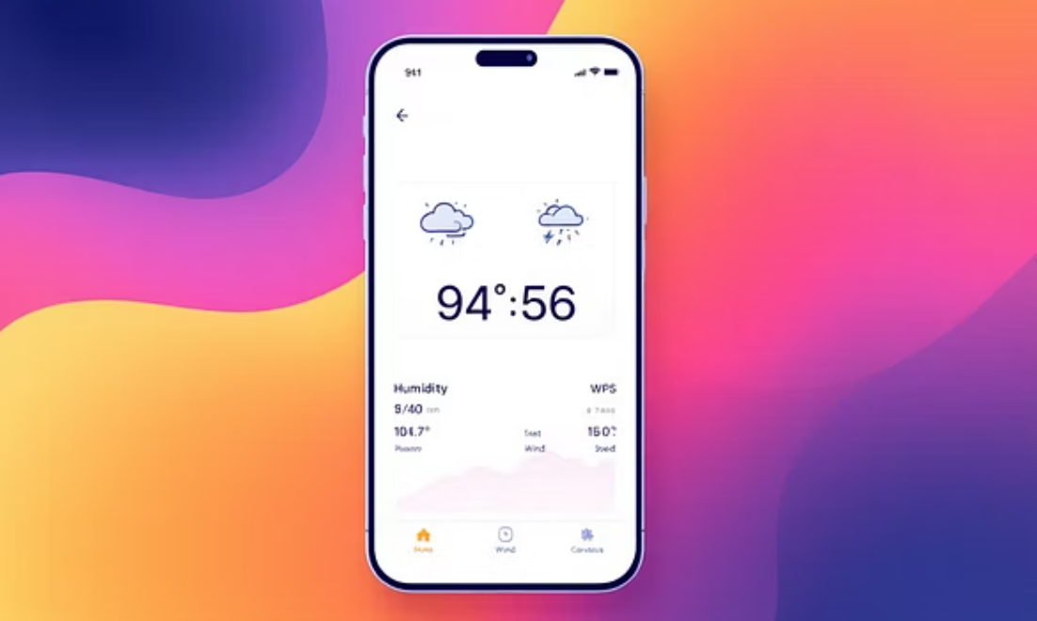
Screenshots & Demo Outputs
Here's a glimpse of our application in action, showcasing its intuitive interface and the clear presentation of weather data. These examples highlight the user experience and data visualization.
The design prioritizes readability and quick access to critical weather information, making it easy for users to get what they need at a glance.

Slide 9




Challenges Faced & Solutions
Developing the Weather Project presented several challenges, from data consistency to API rate limits. We addressed these issues with strategic solutions to maintain system reliability and performance.
Data Inconsistency
API Rate Limits
Geocoding Accuracy
Implemented data validation and fallback mechanisms.
Utilized caching strategies and optimized API calls.
Integrated multiple geocoding services for better precision.

Slide 10




Future Enhancements & Conclusion
The Weather Project is continuously evolving. We have exciting plans for future enhancements to further improve its utility and user experience. Our journey continues with innovation at its core.
Interactive Graphs
Visualize historical weather trends.
Mobile Application
Native apps for iOS and Android.
ML Predictions
Advanced weather forecasting using machine learning.
In conclusion, the Weather Project delivers reliable weather information through a well-architected system, with a clear roadmap for future growth and innovation.

